Slide 1
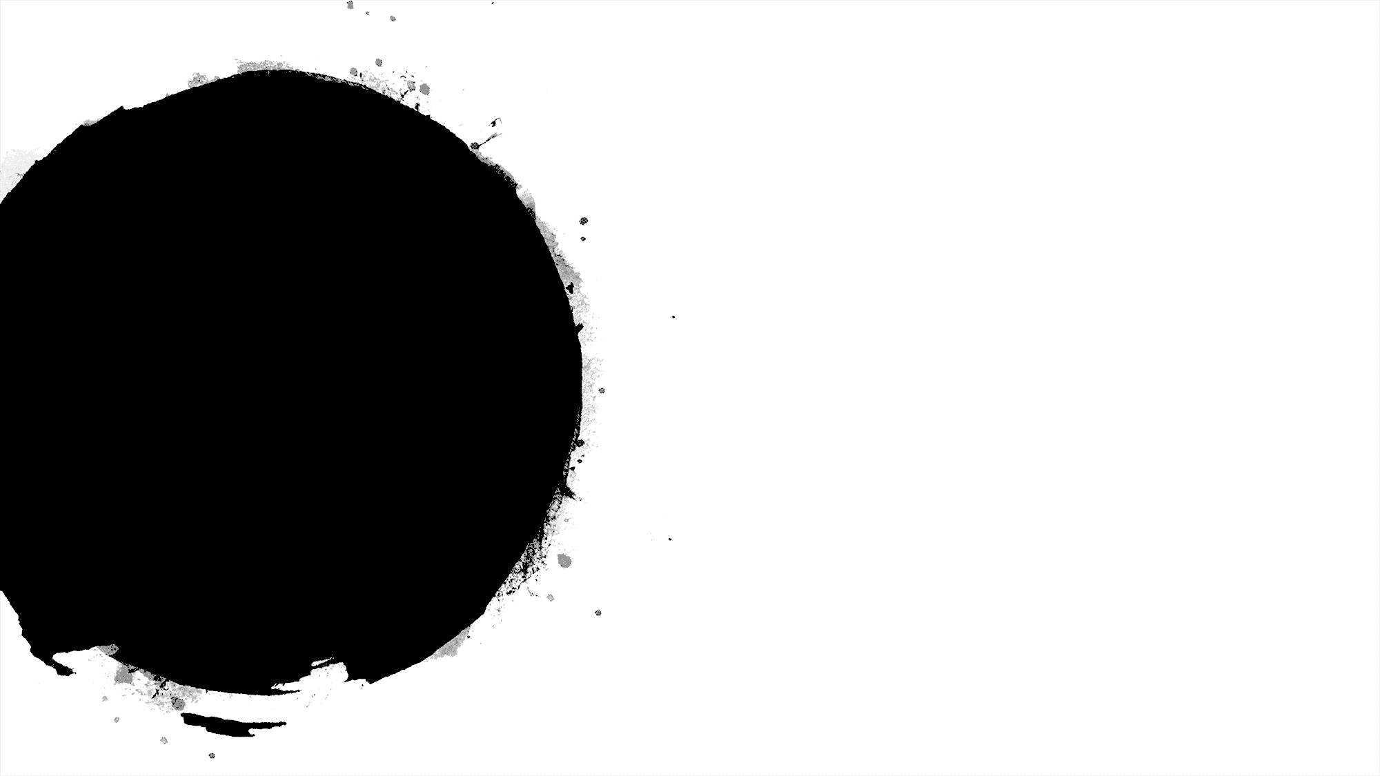

Cricket
Score
Prediction
Presented By:
SK.Gouse Mastan Vali- 17471A0502
D.Vamsi Krishna- 17471A0552
K.S.L.Narayana- 17471A0542
A.Sairam- 17471A0555
Under the guidance of:
P.Lakshmi Narayana M.Tech
Asst professor

Slide 2
Introduction
Cricket is being played in many countries all around the world. There are a lot of domestic and international tournaments being held in many countries which play cricket.
Cricket is a game played between two teams comprising of 11 players in each team. The result is either a win, loss or a tie(same score/weather).
Moreover, this game is also extremely unpredictable because at every stage of the game the momentum shifts to one of the teams between the two.
A lot of times the result gets decided on the last ball of the match where the game gets really close.
Considering all these unpredictable scenarios of this unpredictable game, there is a huge interest among the spectators to do some prediction either at the start of the game or during the game.
So, keeping in mind all these possibilities, this report aims at studying the problem of predicting the game results before the game has started based on the statistics and data available from the data set.

Slide 3
Abstract
Winning is the goal of any sport. Cricket is one the most watched sport now a days. Winning in Cricket depends on various factors like home crowd advantage, performances in the past, experience in the match, performance at the specific venue, performance against the specific team and the current form of the team and the player.
Here we predicts the score of first innings not only based on current run rate but also considers number of wickets fallen, venue ,batting team, batsman, bowler, etc..
to predict the cricket score I have taken the dataset from espn.cricksheet
In this Project, a model has been proposed that predicts the score in each of the innings using Multiple Variable Linear Regression , Random Forest algorithm, Lasso, Ridge, Support Vector Regression.

Slide 4
odi.csv -> 1188 matches (Ball to ball coverage)
Dataset consist of following columns(features):
mid -> Each match is given a unique number
date -> When the match happened
venue -> Stadium where match is being played
bat_team -> Batting team name
bowl_team -> Bowling team name
batsman -> Batsman name who faced that ball
bowler -> Bowler who bowled that ball
runs -> Total runs scored by team at that instance
wickets -> Total wickets fallen at that instance
overs -> Total overs bowled at that instance
runs_last_5 -> Total runs scored in last 5 overs
wickets_last_5 -> Total wickets that fell in last 5 overs
striker -> max(runs scored by striker, runs scored by non-striker)
non-striker -> min(runs scored by striker, runs scored by non-striker)
total -> Total runs scored by batting team after first innings
Dataset

Slide 5
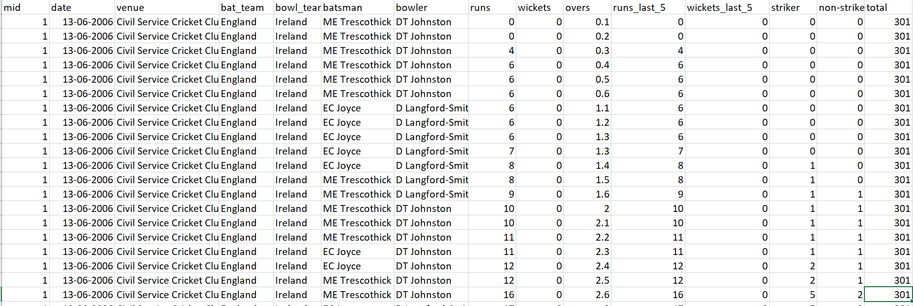
Dataset

Slide 6
Data Pre-Processing
Data preprocessing is a process of preparing the raw data and making it suitable for a machine learning model. It is the first and crucial step while creating a machine learning model.
When creating a machine learning project, it is not always a case that we come across the clean and formatted data. And while doing any operation with data, it is mandatory to clean it and put in a formatted way. So, for this, we use data preprocessing task.

Slide 7
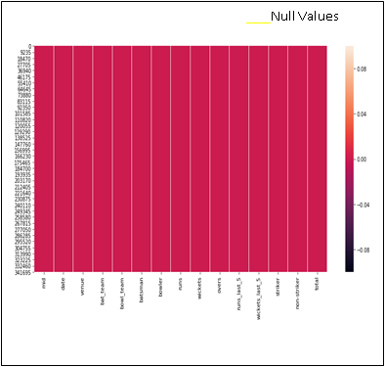
Missing Values or Null Values

Slide 8
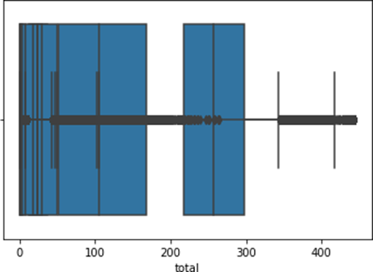
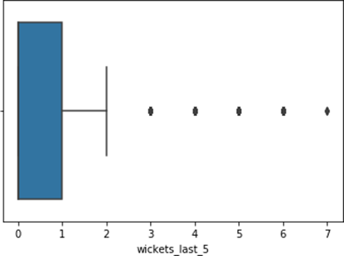
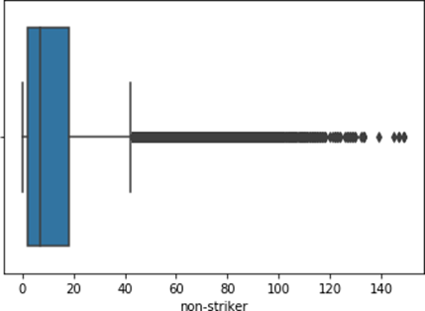
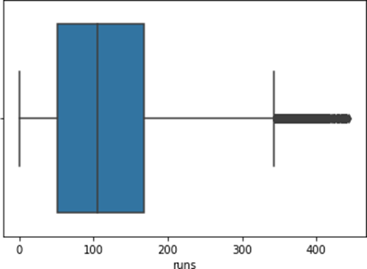
Outliers
An outlier is an object that deviates significantly from the rest of the objects. They can be caused by measurement or execution error. The analysis of outlier data is referred to as outlier analysis or outlier mining.
Most data mining methods discard outliers noise or exceptions, however, in some applications such as fraud detection, the rare events can be more interesting than the more regularly occurring one and hence, the outlier analysis becomes important in such case.

Slide 9
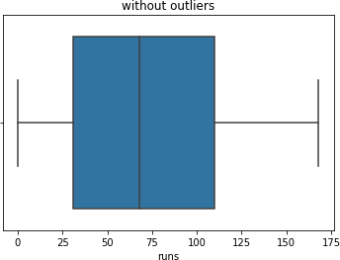
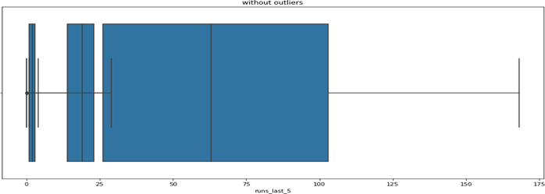
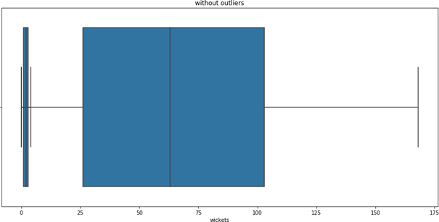
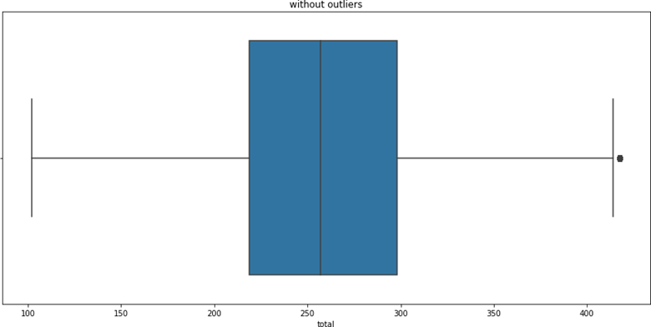
After Removing Outliers:

Slide 10
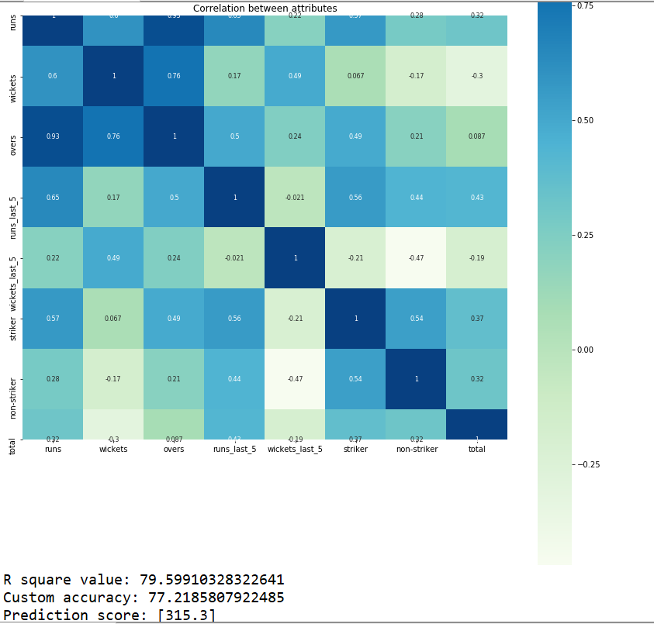
Heat map (Before)
Correlation explains how one or more variables are related to each other. These variables can be input data features which have been used to forecast our target variable. Correlation, statistical technique which determines how one variables moves/changes in relation with the other variable.

Slide 11
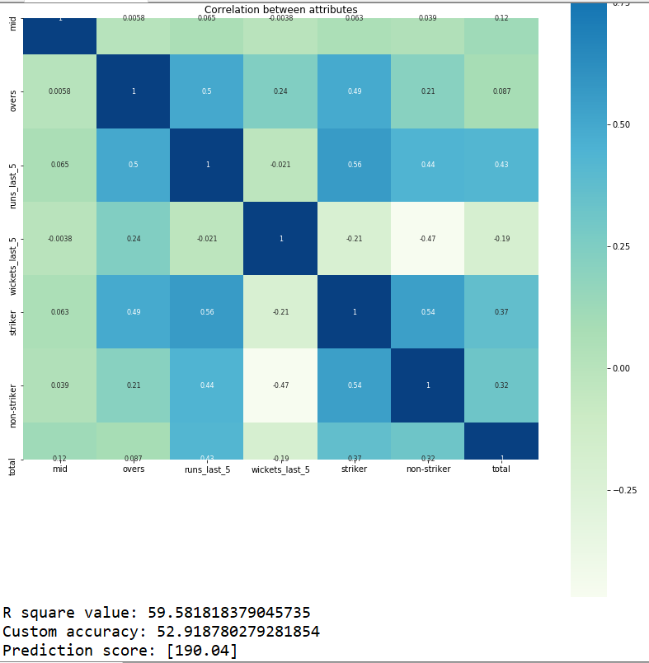
Heat Map (After)

Slide 12
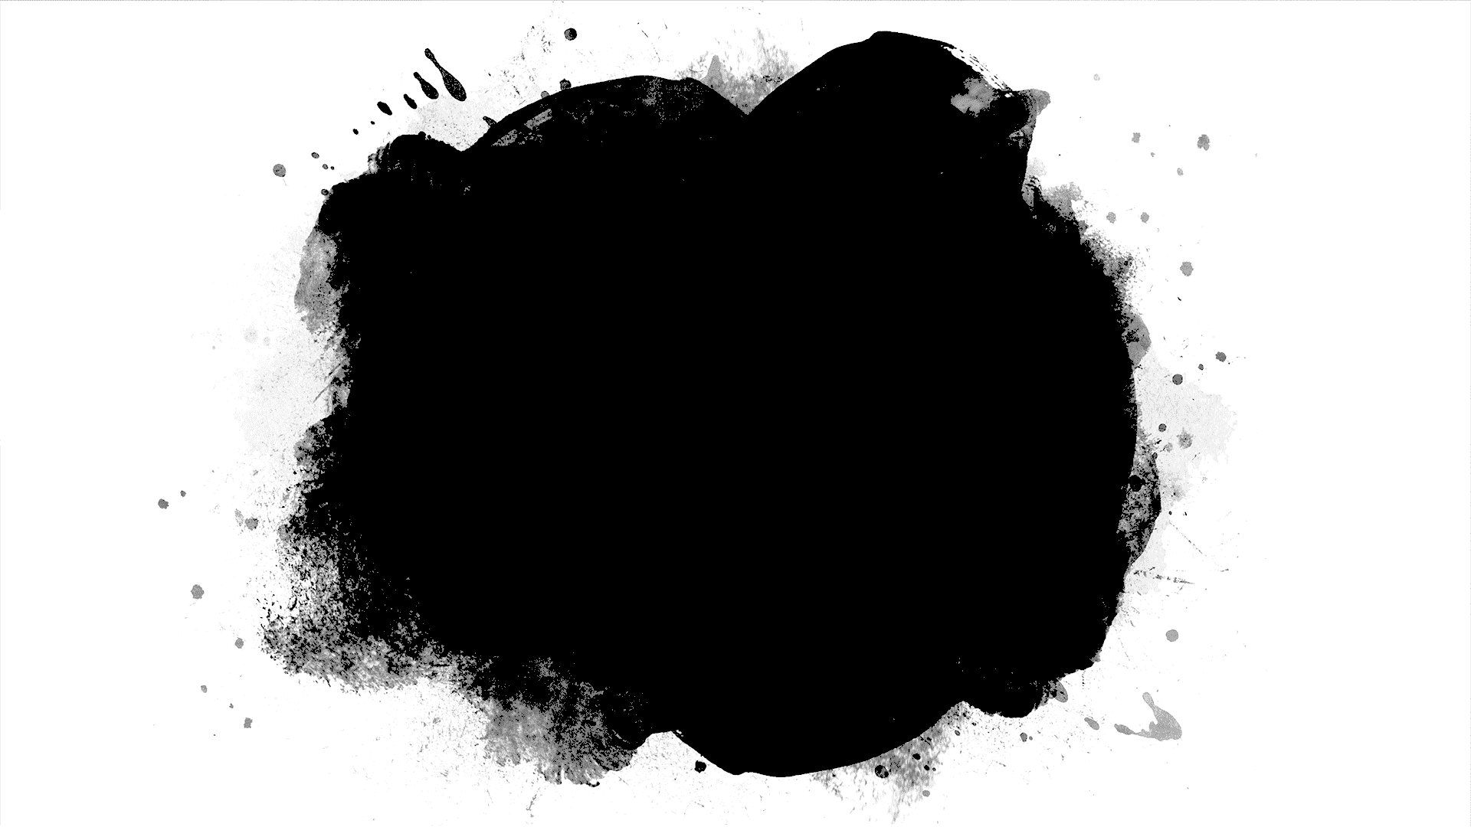
Algorithms

Slide 13
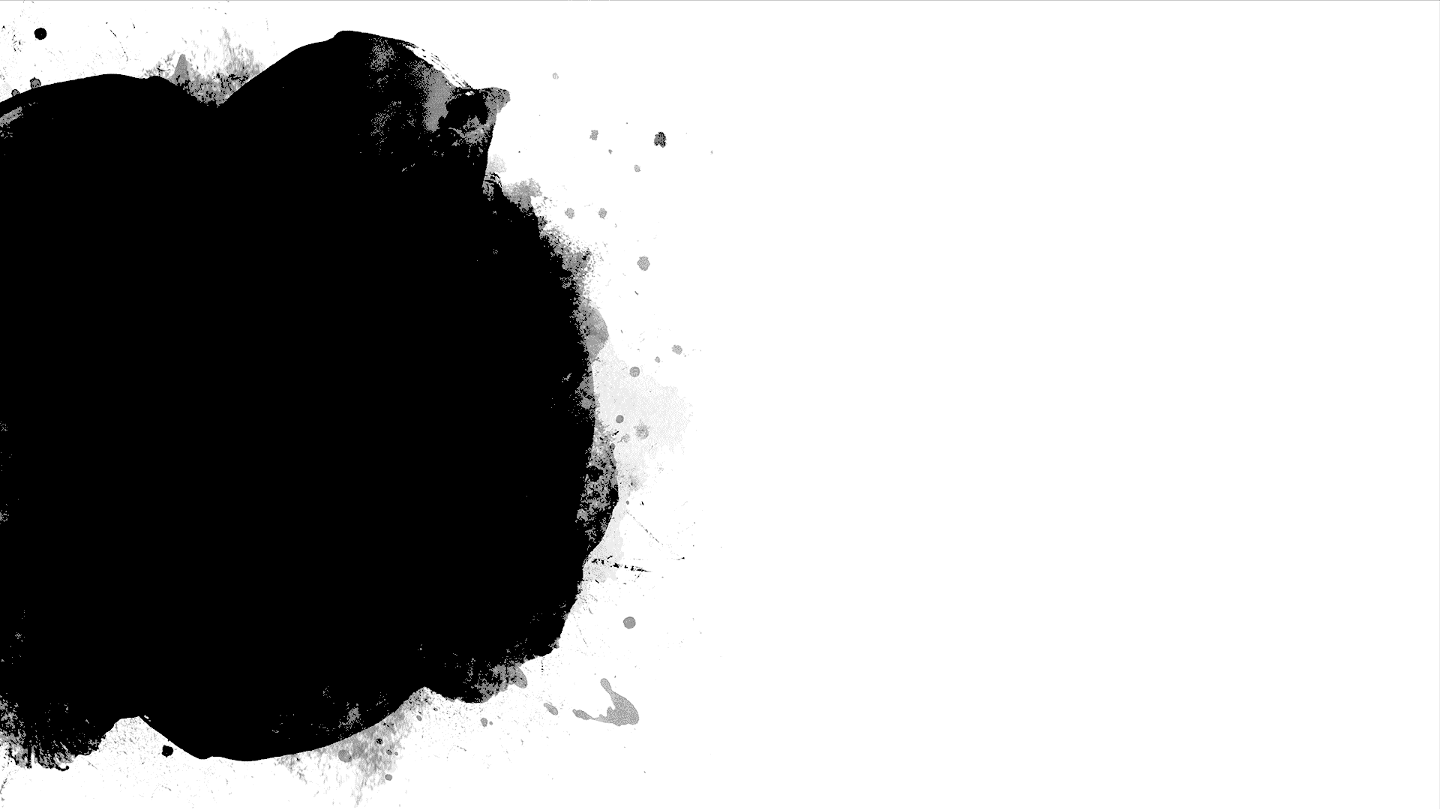
Random Forest is a Supervised Learning algorithm which uses for classification(Fixed) and regression(Continuous data).
It can handle missing values, and also can be modeled for continuous values
It creates decision tree on data samples and then get the prediction from each of them and get the best solution
Random Forest

Slide 14
Linear Regression
Linear regression is a way to explain the relationship between a dependent variable and one or more explanatory variables using a straight line.
Once we use linear regression on a data-set divided into training and test set, calculating the scores on training and test set can give us a idea about whether the model is suffering from over-fitting or under-fitting or none
Linear regression can be used to fit a predictive model to a set of observed values (data).
This is useful, if the goal is prediction, or forecasting, or reduction

Slide 15
Decision Tree Regression
Decision Tree is one of the most used, practical approaches for supervised learning. It can be used to solve both Regression and Classification tasks with the latter being put more into practical application.
It is a tree-structured classifier with three types of nodes. The Root Node is the initial node which represents the entire sample and may get split further into further nodes. The Interior Nodes represent the features of a data set and the branches represent the decision rules. Finally, the Leaf Nodes represent the outcome. This algorithm is very useful for solving decision-related problems.

Slide 16
Support Vector Regression(SVR) is quite different than other Regression models.
It uses the Support Vector Machine algorithm to predict a continuous variable.
While other linear regression models try to minimize the error between the predicted and the actual value, SVR tries to fit the best line within a predefined or threshold error value.
What SVR does in this sense, it tries to classify all the prediction lines in two types, ones that pass through the error boundary( space separated by two parallel lines) and ones that don’t.
Those lines which do not pass the error boundary are not considered as the difference between the predicted value and the actual value has exceeded the error threshold, 𝞮(epsilon). The lines that pass, are considered for a potential support vector to predict the value of an unknown
Support Vector Regression

Slide 17
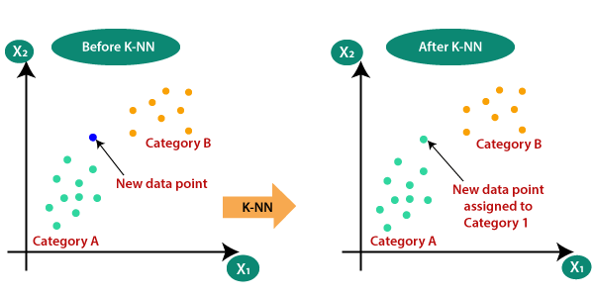
K-Nearest Neighbor(KNN) Algorithm
K-Nearest Neighbor is one of the simplest Machine Learning algorithms based on Supervised Learning technique.
K-NN algorithm assumes the similarity between the new case/data and available cases and put the new case into the category that is most like the available categories.
K-NN algorithm stores all the available data and classifies a new data point based on the similarity. This means when new data appears then it can be easily classified into a well suite category by using K- NN algorithm.
K-NN algorithm can be used for Regression as well as for Classification but mostly it is used for the Classification problems.
It is also called a lazy learner algorithm because it does not learn from the training set immediately instead it stores the dataset and at the time of classification, it performs an action on the dataset.
KNN algorithm at the training phase just stores the dataset and when it gets new data, then it classifies that data into a category that is much similar to the new data.

Slide 18
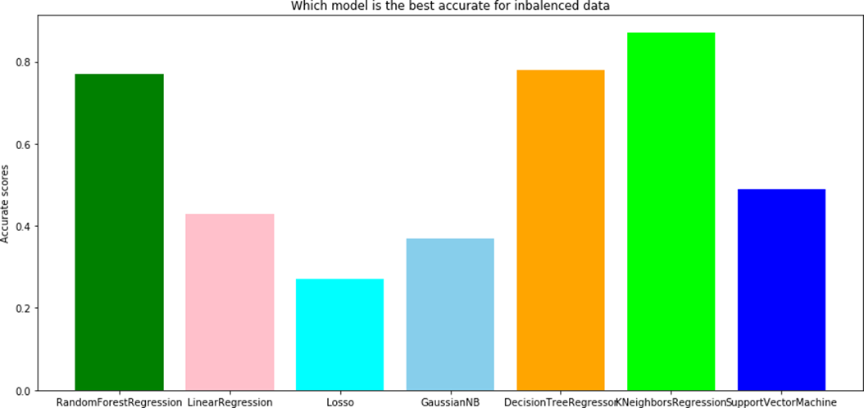
Comparison of algorithms

Slide 19
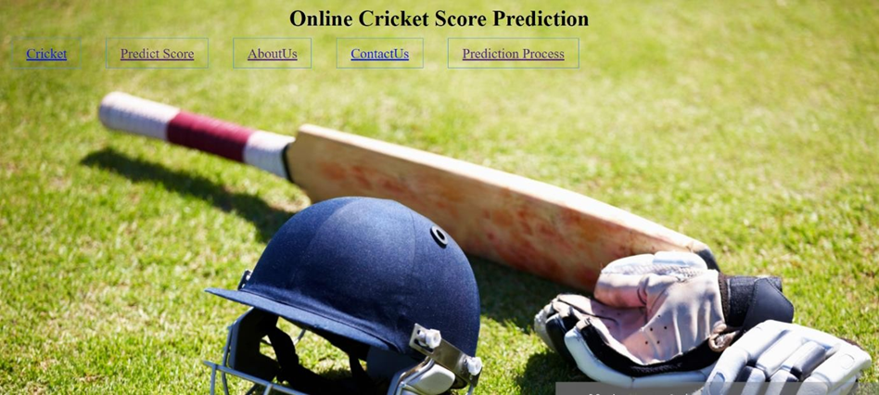
OUTPUTS
Home Page

Slide 20
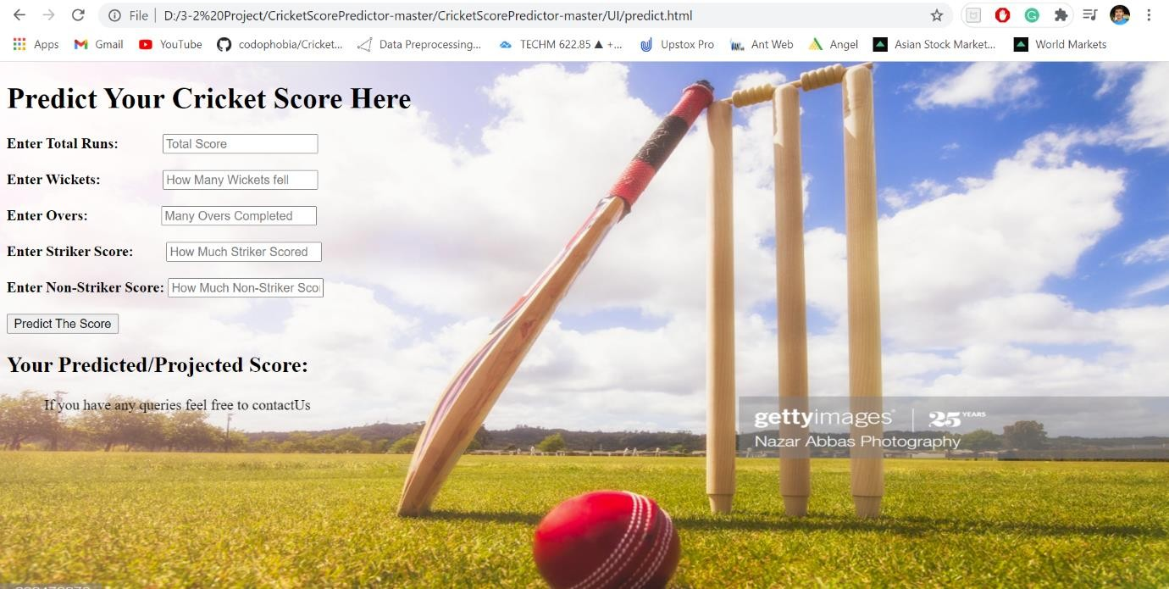
Predict Score Page

Slide 21
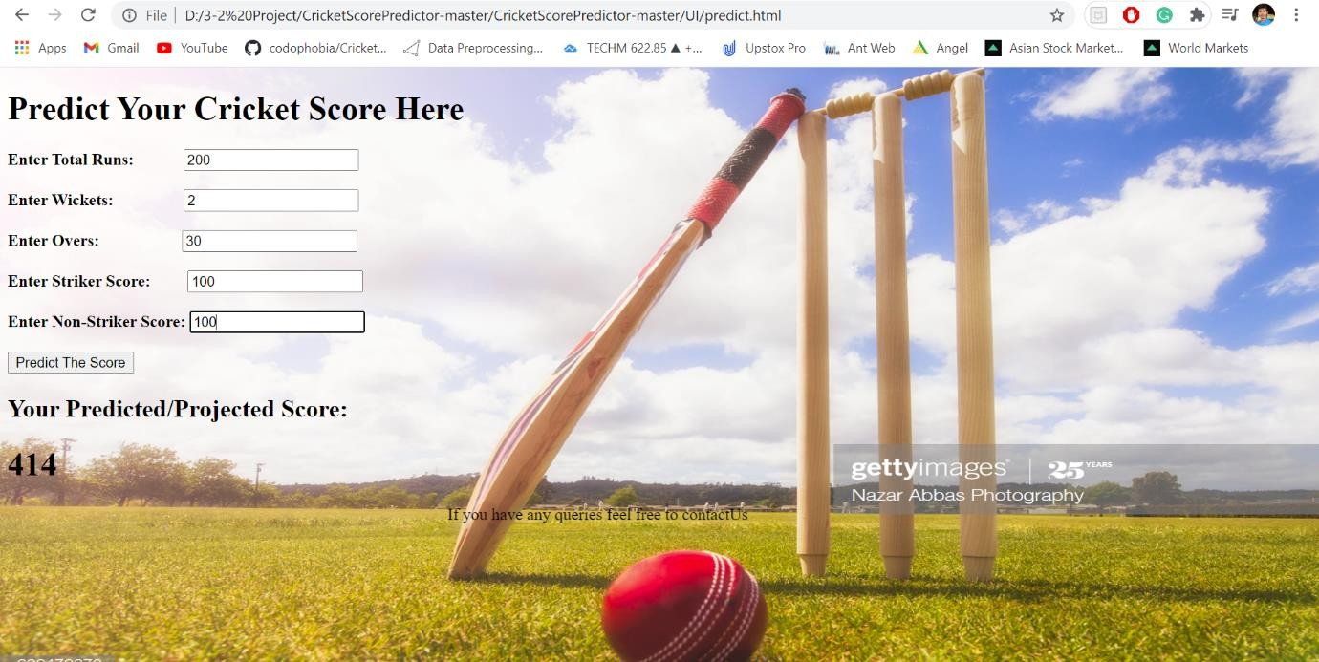
Final Output

Slide 22
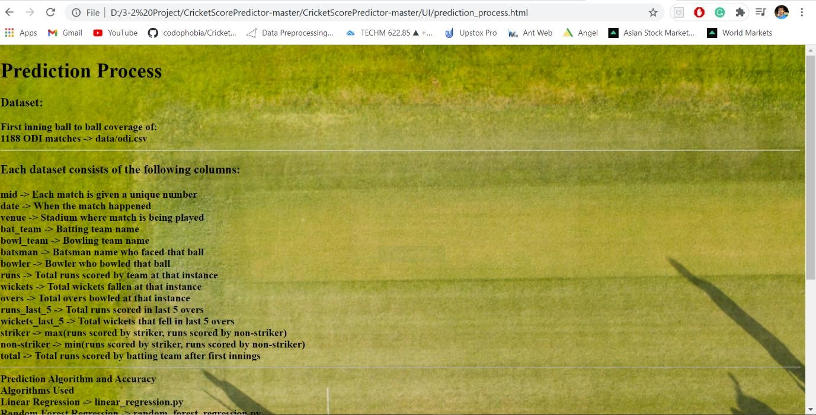
Prediction Process

Slide 23
Conclusion
In this project, we implemented Knearest Kneighbors regression for finding out the cricket score and data from espn website
The main motive of this project is to show how to predict the cricket score with such giant dataset and display the projected score even before match ends.

Slide 24
Future Scope
In future, the application can be enhanced by implementing decision tree regressor algorithm ,k nearest neighbour regression, etc. in which we can find the correlation between every independent variable.
Developing Android app or IOS app or Web application to provide users in an easy manner.

Slide 25

Thank you

